Slide 1
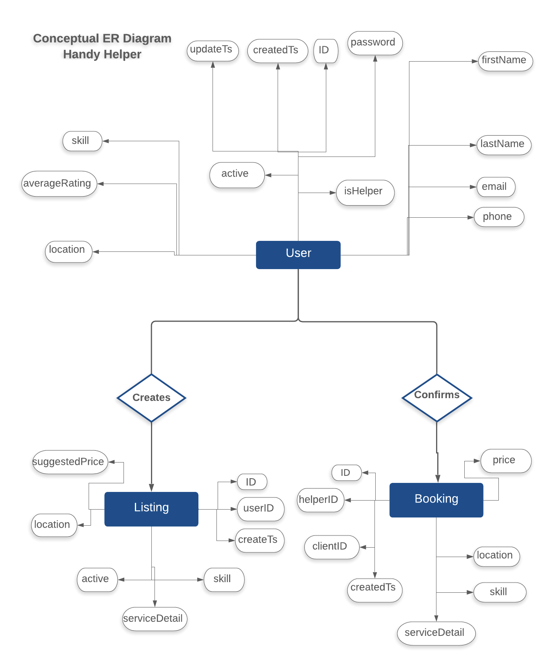
image
availability
location
emailPreferences
Filter Form
price
experience

Slide 2
